Slide 1

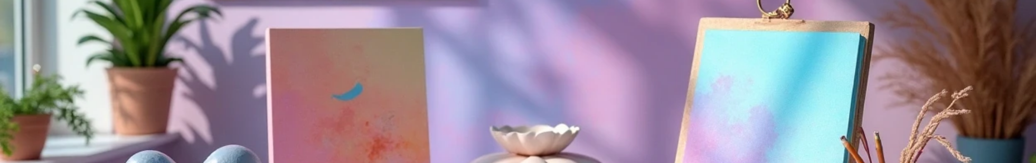

Portfolio of Dhanalakshmi
Author: Jack_sparrow
Created with Pi

Slide 2

CONTENTS
1. About Me
2. Schooling
3. Certificates
4. Projects
5. Hobbies
6. Future Goal

Slide 3

01
About Me

Slide 4

About Me
I am Dhanalakshmi, a passionate B.Sc Computer Science student at Government Arts and Science College, Anthiyur.

Slide 5

02
Schooling

Slide 6
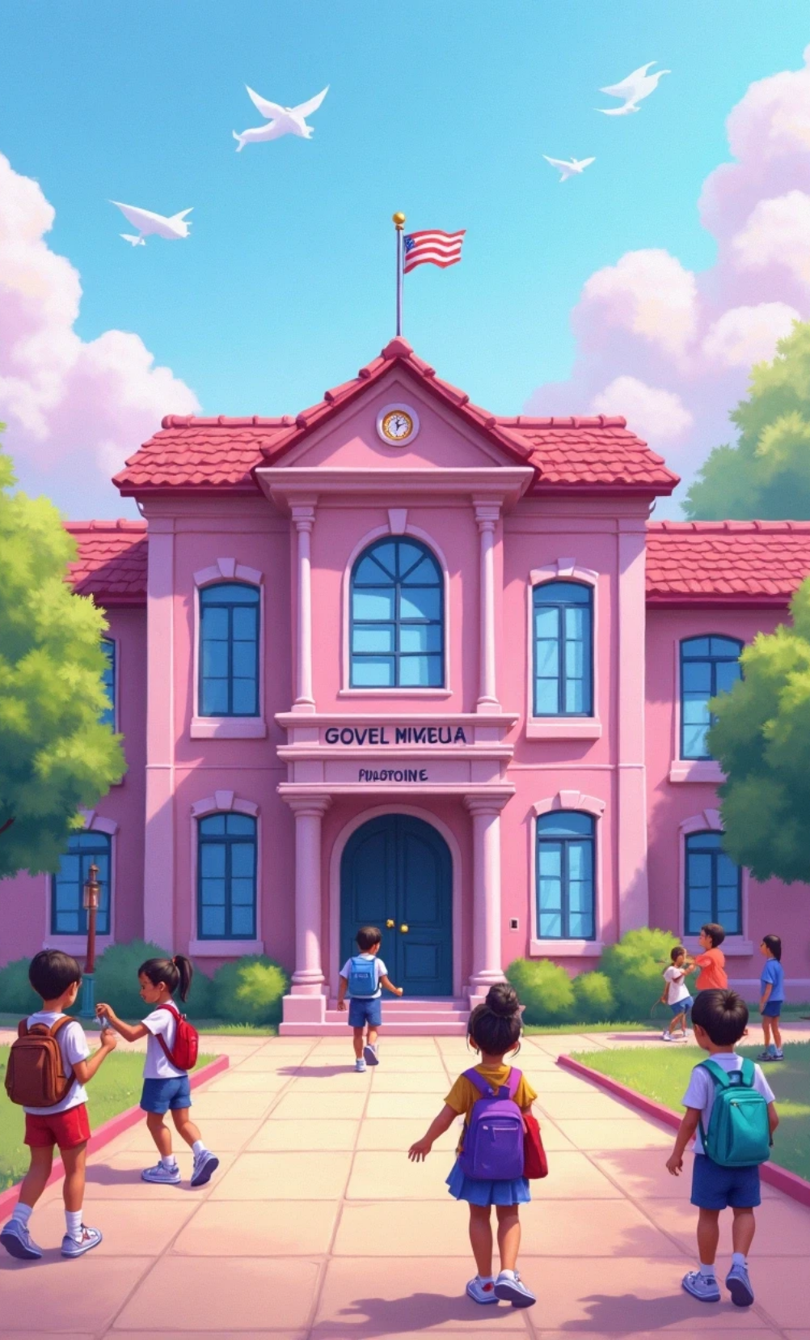
Schooling
I completed my schooling (1st–12th) in Government School.

Slide 7

03
Certificates

Slide 8
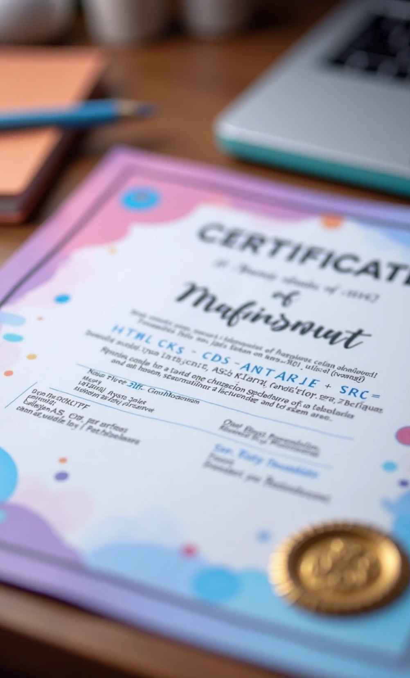
Certificates
Naan Mudhalvan- HTML
Naan Mudhalvan- CSS
Naan Mudhalvan- JavaScript

Slide 9

04
Projects

Slide 10

Projects
Registration Form
Time Table

Slide 11

05
Hobbies

Slide 12
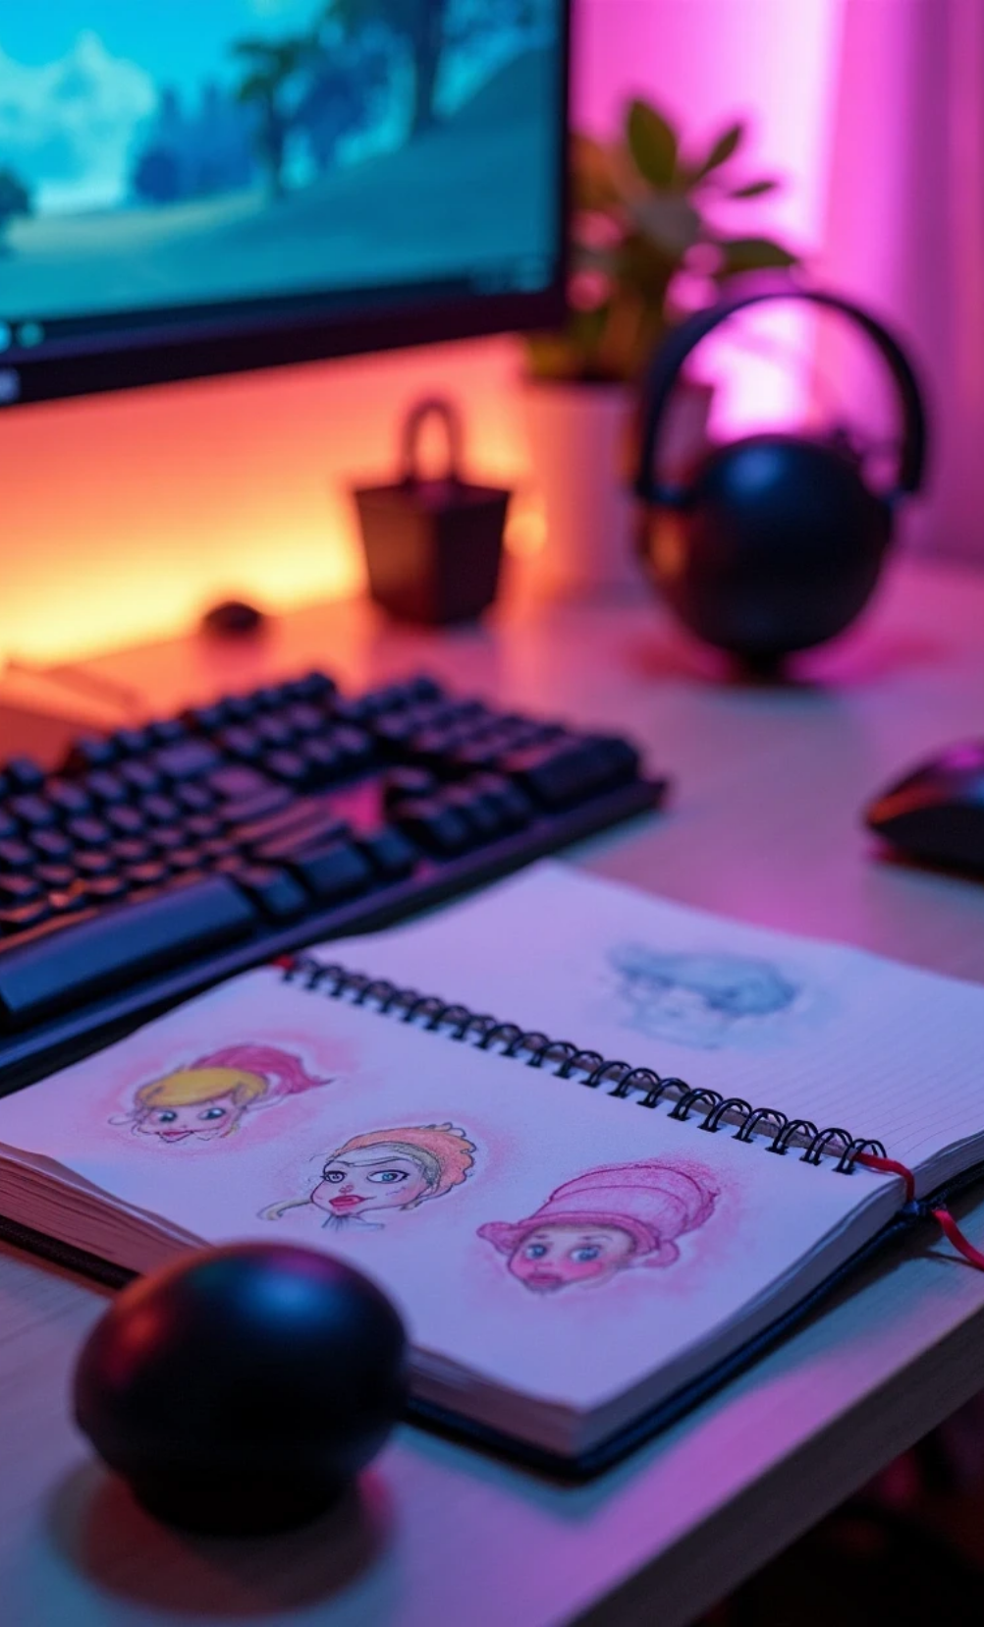

Hobbies
Gaming
Web Development
Drawing
Practical Learning

Slide 13

06
Future Goal

Slide 14
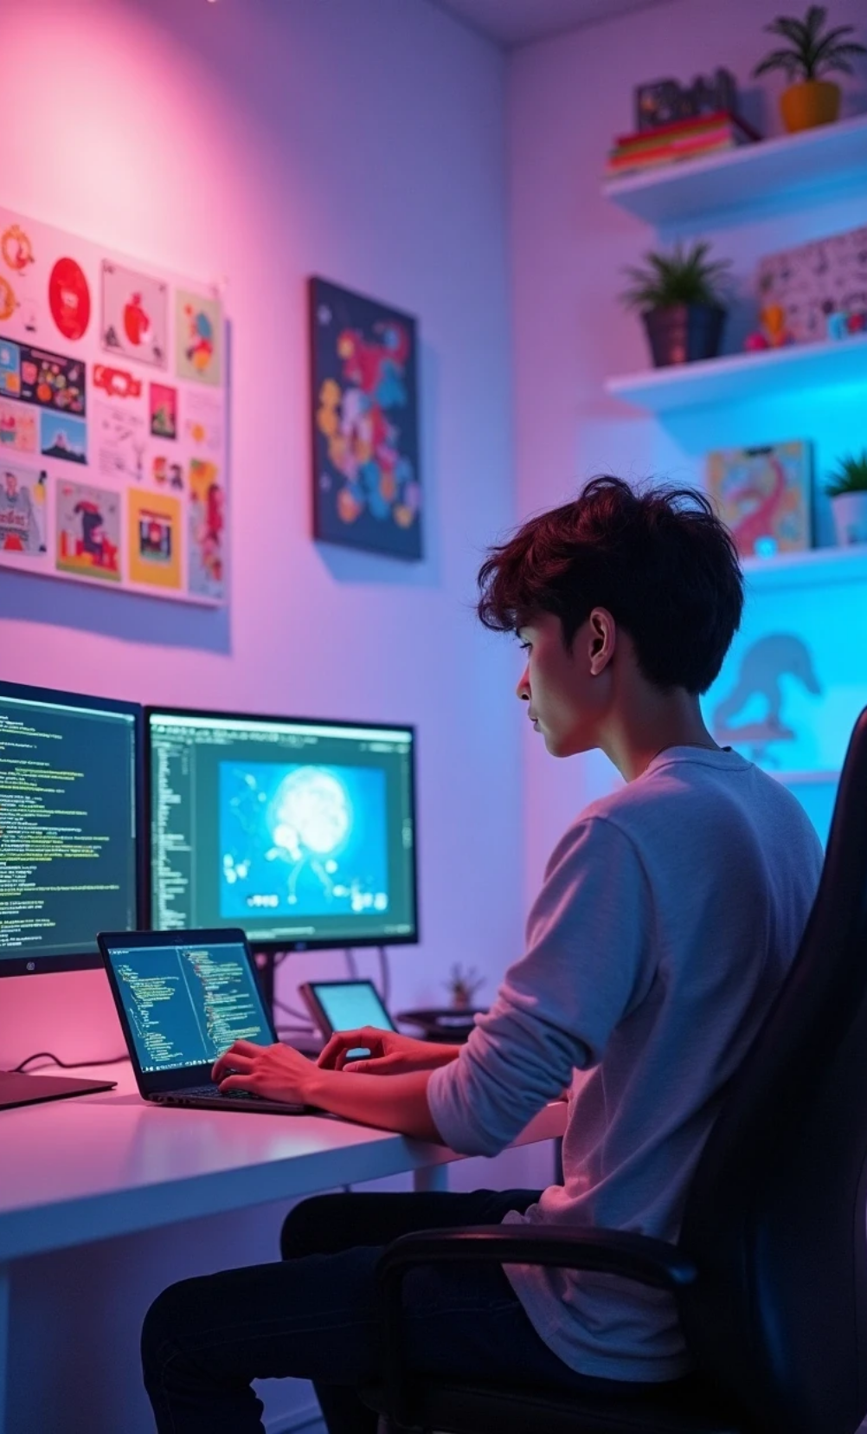
Future Goal
To master Java and become a Game & App Developer.

Slide 15

Thank You

